Slide 1

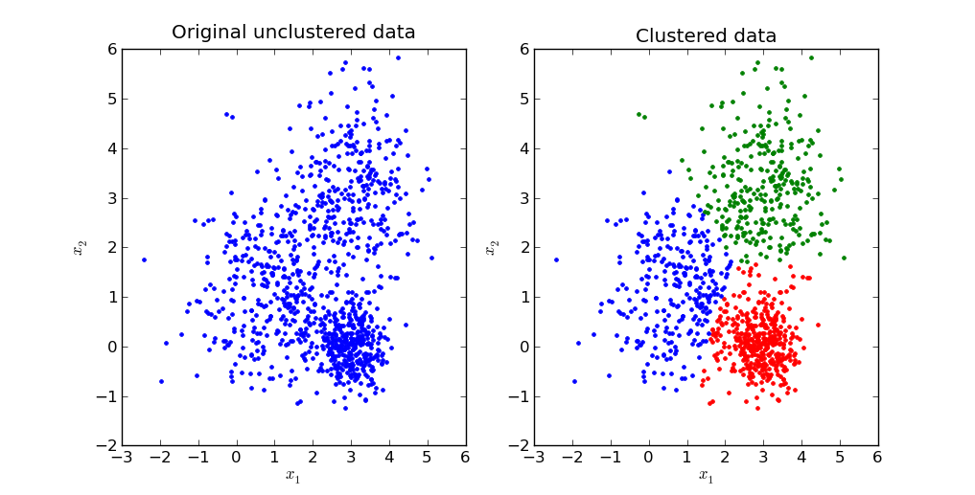
Clustering using K-Means
www.cargill.com

Slide 2
What is Cluster Analysis?
Cluster: a collection of data objects
Similar to one another within the same cluster
Dissimilar to the objects in other clusters
Cluster analysis
Finding similarities between data according to the characteristics found in the data and grouping similar data objects into clusters
Unsupervised learning: no predefined classes
Typical applications
As a stand-alone tool to get insight into data distribution
As a preprocessing step for other algorithms

Slide 3
Clustering: Rich Applications and Multidisciplinary Efforts
Pattern Recognition
Spatial Data Analysis
Create thematic maps in GIS by clustering feature spaces
Detect spatial clusters or for other spatial mining tasks
Image Processing
Economic Science (especially market research)
WWW
Document classification
Cluster Weblog data to discover groups of similar access patterns

Slide 4
Examples of Clustering Applications
Marketing: Help marketers discover distinct groups in their customer bases, and then use this knowledge to develop targeted marketing programs
Land use: Identification of areas of similar land use in an earth observation database
Insurance: Identifying groups of motor insurance policy holders with a high average claim cost
City-planning: Identifying groups of houses according to their house type, value, and geographical location
Earth-quake studies: Observed earth quake epicenters should be clustered along continent faults

Slide 5
Similarity and Distance
K-means and all methods group together the most similar objects
Where some notion of distance is used to define similarity
Close-by, i.e., similar
Far apart, i.e. dissimilar
Distance obvious in our XY planes, not so obvious in general: categorical, boolean, vectors, etc.

Slide 6
K-Means
K-means (MacQueen, 1967) is one of the simplest clustering algorithms to minimize distance from centers.
Place K points into the space represented by the objects that are being clustered. These points represent initial group centroids.
Assign each object to the group that has the closest centroid.
When all objects have been assigned, recalculate the positions of the K centroids.
Repeat Steps 2 and 3 until the centroids no longer move. This produces a separation of the objects into groups from which the metric to be minimized can be calculated.

Slide 7
K-means example, step 1
k₁
Y
Pick 3
initial
cluster
centers
(randomly)
k₂
k₃
X

Slide 8
K-means example, step 2
k₁
Y
k₂
Assign
each point
to the closest
cluster
center
k₃
X

Slide 9
K-means example, step 3
k₁
k₁
Y
Move
each cluster center
to the mean
of each cluster
k₂
k₃
k₂
k₃
X

Slide 10
K-means example, step 4
Reassign
points
closest to a different new cluster center
Q: Which points are reassigned?
k₁
Y
k₃
k₂
X

Slide 11
K-means example, step 4
Reassign points
to the closest center
Q: points reassigned:
k₁
Y
k₃
k₂
X

Slide 12
K-means example, step 5
k₁
k₁
Y
re-compute cluster means
k₂
k₃
k₂
k₃
X

Slide 13
K-means example, step 6
Reassign points to clusters:
No change:
The end
k₁
Y
k₂
k₃
X

Slide 14
K-means clustering summary
Advantages
Simple, understandable
items automatically assigned to clusters
Disadvantages
Must pick number of clusters before hand
All items forced into a cluster
Too sensitive to outliers

Slide 15
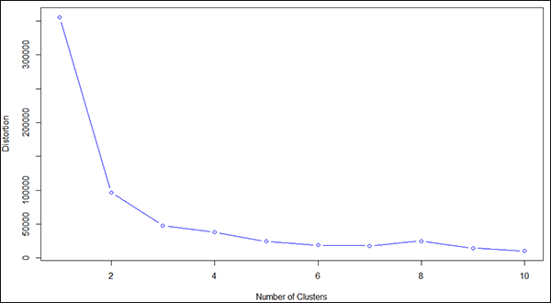
Determining the number of clusters K and measuring homogeneity
Cohesion is measured by the within cluster sum of squares - SSE or WSS
Where |C_{i}| is the size of cluster i
A WSS plot of the within groups sum of squares by number of clusters extracted can help determine the appropriate number of clusters. We can look for a bend in the plot and select that as number of clusters

Slide 16
Example in R with IRIS dataset
head(iris)
x = iris[,-5]
y = iris$Species
wss = numeric(15)
set.seed(10)
for (k in 1:15) wss[k] = sum(kmeans(x, centers=k, nstart=25)$withinss)
plot(1:15, wss, type="b", xlab="Number of Clusters", ylab="Within Sum of Squares")
flower_clusters = kmeans(x,3)
flower_clusters
table(y,kc$cluster)
plot(x[c("Sepal.Length", "Sepal.Width")], col=kc$cluster)
points(kc$centers[,c("Sepal.Length", "Sepal.Width")], col=1:3, pch=23, cex=3)

Slide 17
Example in R with UCI - Wholesale customer data
wcd1 = read.csv("Wholesale customers data.csv") # reading data into a variable
wcd2 = wcd1[3:8] #copying coolumns # copying 3 to 8th columns of wcd1 into wcd2
wss_wcd = numeric(20) # creating a vector for storing 20 values of WSS
for(k in 1:20) wss_wcd[k] = sum(kmeans(wcd2, centers = k, nstart=50)$withinss) # calculating wss for different values of k
plot(1:20, wss_wcd, type ='b') # plotting wss for different values of k
wcd3 = kmeans(wcd2, 5) # apply kmeans algorithm and store in wcd3
str(wcd3) # understanding structure of wcd3
wcd1$clusterdetail = wcd3$cluster # added cluster id column in your main dataset
View(wcd1)

Slide 18
Example in R SNS data
from chap-9, Machine Learning with R Second Edition - Brett Lantz

